Slide 1
Predicting binding affinity in a multi-species ligand-receptor system
Ashton Berger, James Corbin, Willie Man, and Rachel-Anne Arthur

Slide 2
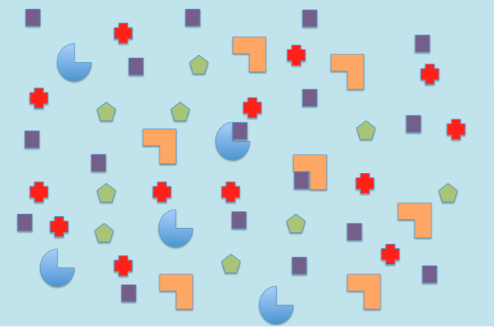
Background
Imagine a system with several ligand species and several receptor species… how do we find out which receptors and ligands will bind and how effective?
Ligand 1
Receptor 1
Receptor 2
Ligand 2
Ligand 3
Notes:
FROM WIKIPEDIA: Ligand - an ion or molecule (functional group) that binds to a central metal atom to form a coordination complex.
Receptor -

Slide 3


Background Continued
Given the estimated -dG values between every bound ligand-receptor complex, we can estimate a probability score of observing a given pairing by modifying the canonical partition function for the Boltzmann distributions of the dG values. The lower the dG values, the more likely there would be a pairing. A positive value represents binding that will not occur as per thermodynamics. A probability score is calculated based on dG values.
Use dG estimates for every ligand-receptor pairing...
...and divide by the sum of all of the dGs for the other pairings the respective ligand and receptor are involved in for a resulting probability score.
Notes:
Based on the canonical partition function from statistical mechanics

Slide 4
Problem:
How do we do the calculations for systems where the N ligands and N receptors is huge? That’s a lot of calculations and how well does it scale with larger numbers?
Solution:
Frame problem in a way to take advantage of the Stampede cluster using C code with sample experimental data and statistical analysis. Utilizing parallel programming to efficiently perform calculations
Notes:
FROM WIKIPEDIA: Ligand - an ion or molecule (functional group) that binds to a central metal atom to form a coordination complex.
Receptor -

Slide 5
Tentative Algorithm
Read input file .csv and store dG pairings in array
Reads user inputted parameters of amount of Ligands and Receptors represented in the Matrix into linked lists or similar structure that contains lists of interacting ligand and receptor complexes
Iterate over every list using loop, convert dGs of pairings to Boltzmann factors, and then divide every dG pairing by the sum of the other values in the lists that correspond to the other interacting pairings to receive results, and store results in array
Return output file .csv containing probabilities based on the Boltzmann distribution
Flaws: too many calculations for one loop. Bulky and slow because of iterative loops. Memory expensive

Slide 6
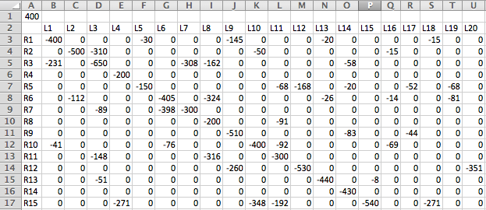
Framing the problem like this is a huge optimization in itself! It allows formatting of the data in arrays that allow us to keep track of pairings and sums based on index alone
dG value (binding energy) between Ligand and Receptor
Temperature in Kelvins for the system
The way the arrays are stored allow us to utilize the trivial functionality of the Intel Cilk Plus library for multicore and vector processing
Notes:
Sample matrix containing -dG values of ligand-receptor pairings for 20 ligand species and 15 receptor species

Slide 7
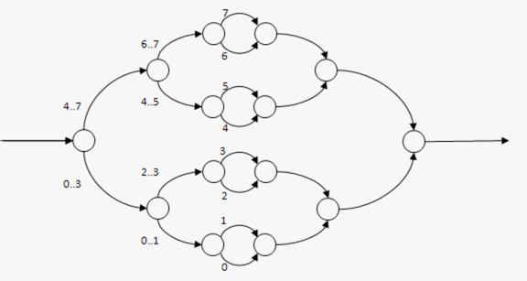
Row and Column Sum Calculations
Iterate over each column or row and sum them.
Without parallelizing our code, large data sets would take long time to do the calculations for
By using a cilk_for loop when calculating the row and column sums, we take advantage of the stampede cluster
Compiler and runtime cooperate to divided in the work of the loop in half, and then in half again, and again as needed until the work is spread over across different cores
source: www.cilkplustutorial.org

Slide 8
Optimized Algorithm
Read input file and store with a malloc
Store Boltzmann factor of -dG of pairings from input file in a sorted data structure efficiently using allocated memory with malloc
Create an array containing the summed Boltzmann factors for every ligand column using a parallel cilk_for loop on the inner loop
Create an array containing the summed Boltzmann factors for every receptor row using a parallel cilk_for loop on the inner loop
Iterate over the sorted data structure and replace -dG Boltzmann factors with P values using a parallel cilk_for loop on the inner loop
Print output to csv file

Slide 9


Optimization Results
Finally we iterate over the matrix and divide every Boltzmann factor value by the sum of the respective ligand and receptor partition functions
Utilized a cilk_for to perform the inner loop
Program Timing Example (1000x1000 test data):
with Cilk: without:
*This is for a medium data set, with a large one the difference would be greater.
total CPU time: 0m4.080s
total CPU time: 0m7.763s
Notes:
divide every Boltzmann factor value by the sum of the respective ligand and receptor partition functions

Slide 10
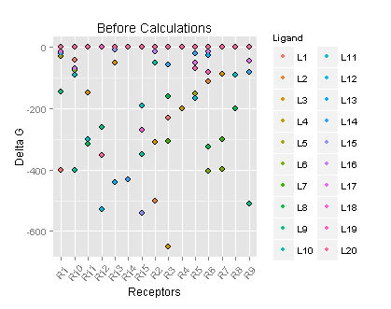
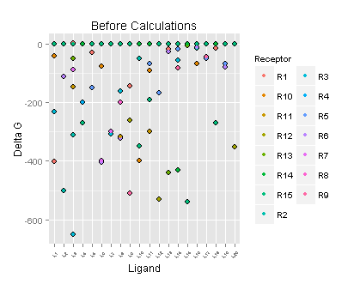
Delta G (kJ/mol * K) Before Calculations
Notes:
Based on given experimental data

Slide 11
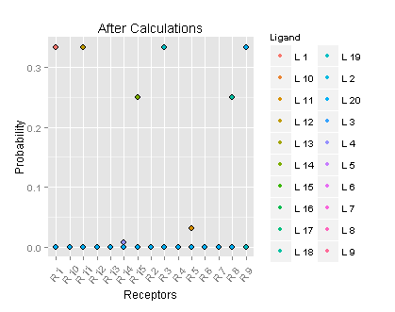
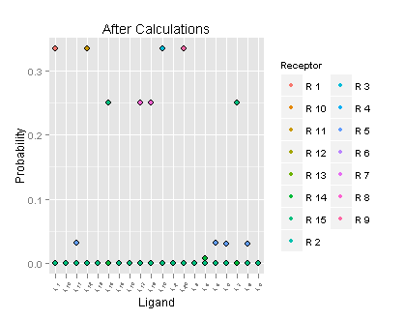
Probabilities After Calculations
Boltzmann factors are first calculated with each ligand-receptor binding and a probability is finally calculated to observe likely bindings

Slide 12
Make
Project DAG
Ligand
ligand_receptor.o
lrfunctions.o
ligand_receptor.h
lrheader.h
lrfunctions.h

Slide 13
Questions?
The End!

Slide 14
Background Summary
In biophysics, the probability of a ligand-receptor complex forming can be calculated using the canonical partition function
For ligand-receptor complexes that do form, the degree to which they do so varies between different ligand-receptor pairings
Our project’s goal was to efficiently and accurately calculate the degree of binding for ligand-receptor pairs in a complex system using statistical physics techniques and parallel computing
Based on -dG values, a favorable ligand-receptor pairing could be further investigated and used to predict possible inter-species pairing.

Slide 15
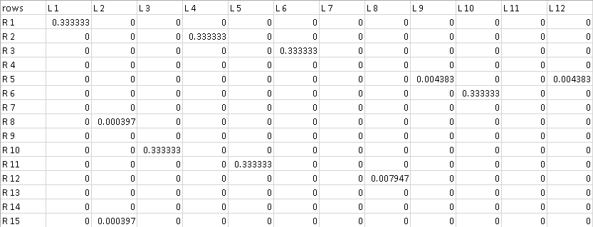
Example Output CSV

